Slide 1

MIDTERM presentation Customization of RISCV Code and Backend Design of a RISCV Processor
By: Omar Sharafy, Muhammad Biadsy
Instructor: Amnon
VLSI Lab
Winter Semester 2024/25

Slide 2
Agenda
Background
Project definition and goals
Alternative solutions
Architectural design of the selected solution
Status - What has been done
Tasks and schedule for the remaining part

Slide 3
BACKGOUND & Motivation
RISC-V is a simple architecture which is being taught in “digital systems & computer structure”.
The purpose of this project is to take the pipelined version of RISC V presented in the course and prepare it for a potential fabrication, while making other changes that will reduce the.
The original code needs to be modified to allow the backend stages to be executed correctly.

Slide 4
Goals
Replacing non-synthesizable memory-loading techniques with an external interface.
Upgrading inefficient course-provided memories to compact, compiled memories, which are more power and size effective.
Adding debug capabilities for accessing internal registers post-fabrication.
Performing a full physical design flow to optimize frequency by refining Verilog code.

Slide 5
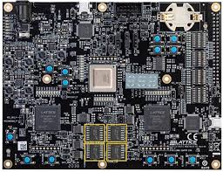
Alternative solutions
the RISC-V Prosser that we work with can FPGA memories and the control unit as a debug tool to monitor internal signals, while leveraging the initial lines of code to load the desired memory into the compiled memory.
While this solution is possible, FPGA memories are not effective size or power wise.

Slide 6
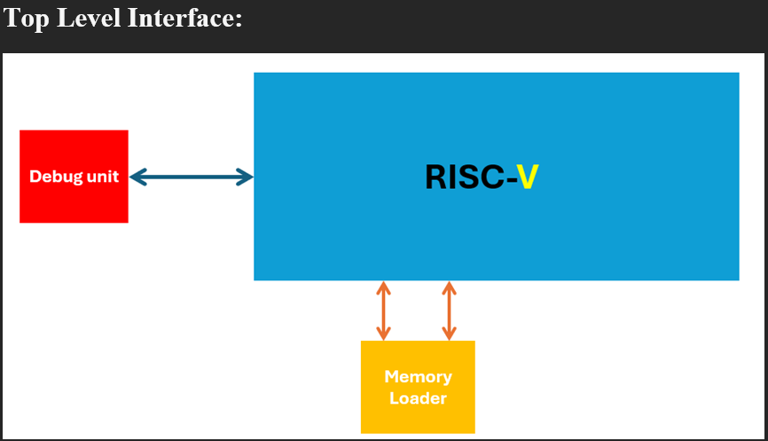
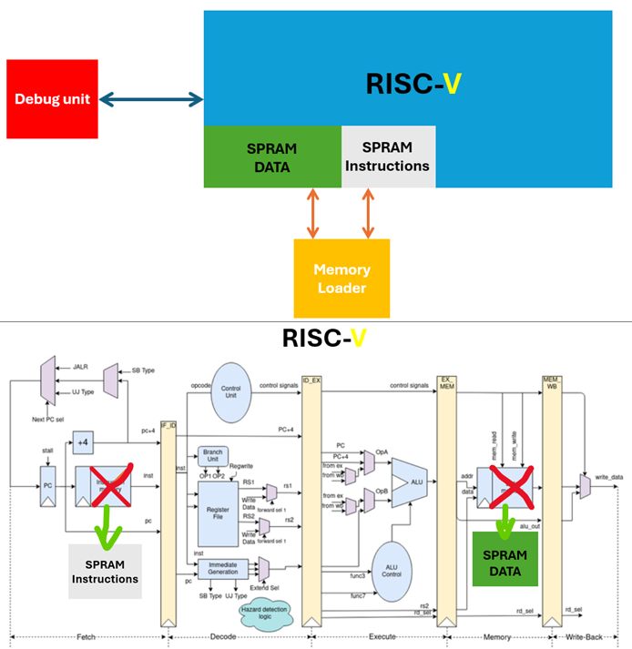
Architectural design of the selected solution

Slide 7
Architectural design
Using SRAM memories, which are area & power efficient, allowing simultaneous read and write operations to multiple addresses.
Create a dedicated debugging unit, separate from the control unit, to load the memories before initiating any tests and provide additional debugging capabilities.

Slide 8
What have we achieved till now?
Make the necessary changes to the initial RSIC-V Module to allow simulations.
Replace data memories with SRAM memories, while keeping the same Processor functionally.
Replace Instruction memories with SRAM memories.
Currently working on creating the debug unit, to allow external interference the loads the memory & provide debug capabilities.

Slide 9
Gant diagram
| 18Aug24 | 25Aug24 | 1Sep24 | 22Sep24 | 29Sep24 | 5Oct24 | 19Oct24 |10Nov24
Today
Exams
layout
Designing a case via 3D Printer
Software development
Debug
Hardware bring-up
Integration
Final presentation

